Slide 1
Unit 3 – lesson 2
THIS IS TONY
Teacher: Ms Thom

Slide 2
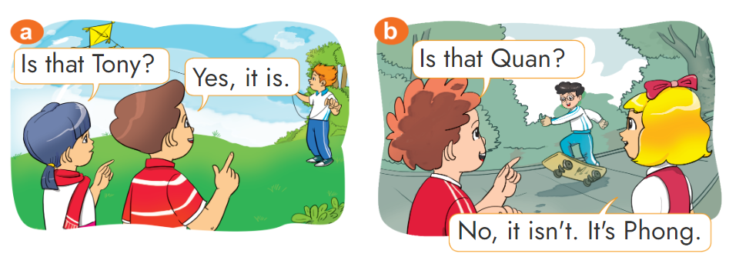
1. Look, listen and repeat

Slide 3
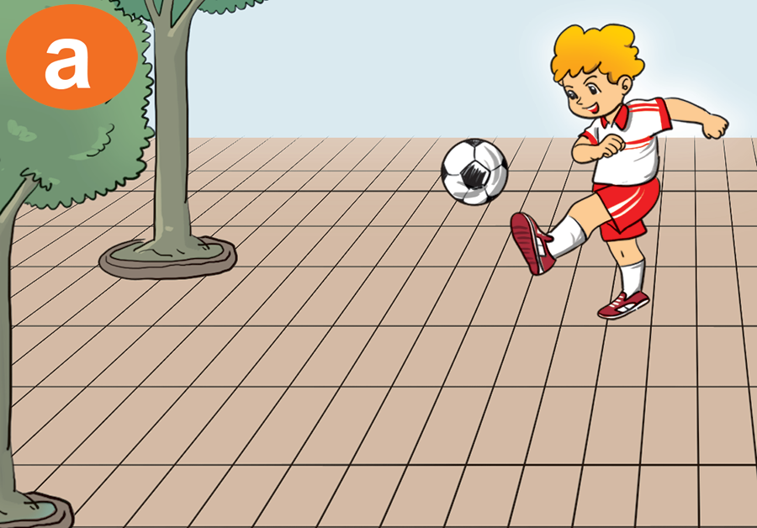
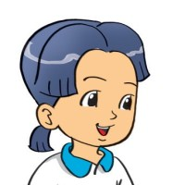
2. Point and say.
Is that _________?
Peter
Yes, it is.

Slide 4
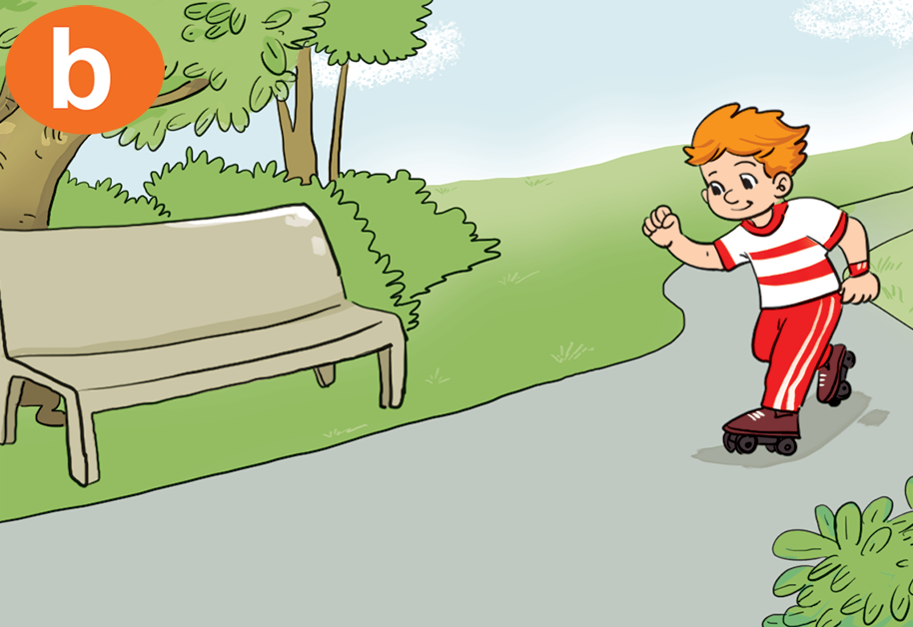
2. Point and say.
Is that _________?
Tony
Yes, it is.

Slide 5
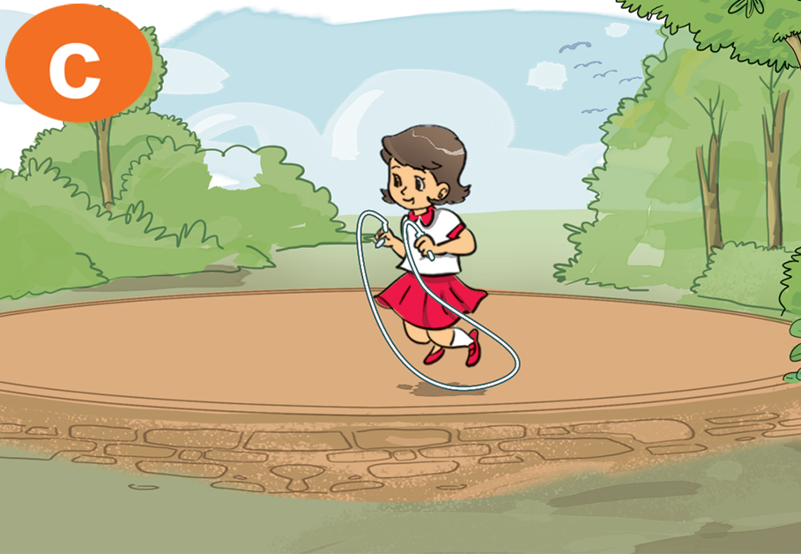
2. Point and say.
Is that _________?
Mai
No, it isn’t.
It’s Hoa.

Slide 6
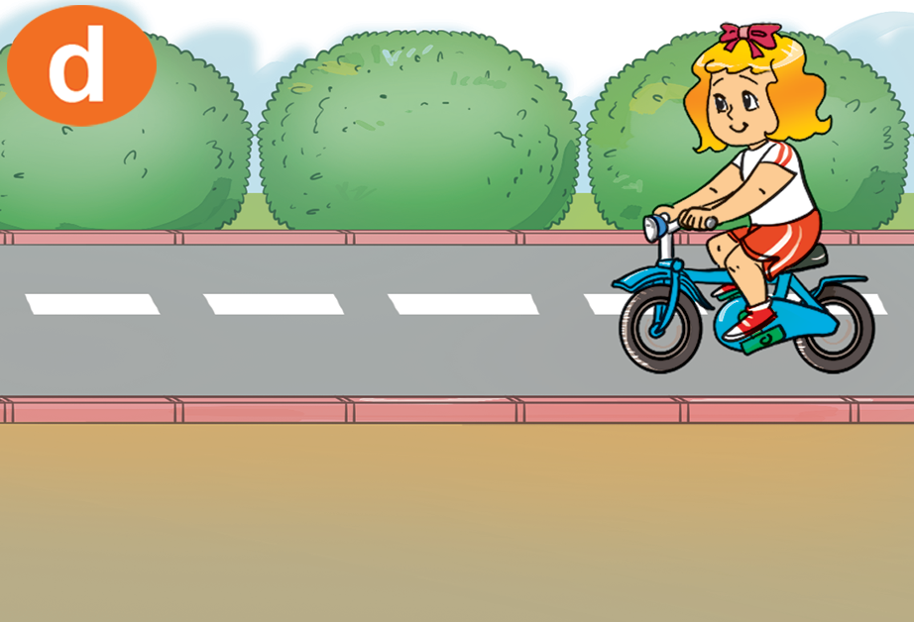
2. Point and say.
Is that _________?
Mary
No, it isn’t.
It’s Linda.

Slide 7
Structures
1. Cách hỏi kia là ai đó có phải không?
Is that + name?
(Kia là …. có phải không?)
Yes, it is.
(Vâng, đúng vậy)
No, it isn’t.
(Không, không phải)
2. Giới thiệu MỘT NGƯỜI ở xa
That is + name.
(Kia là ….)

Slide 8
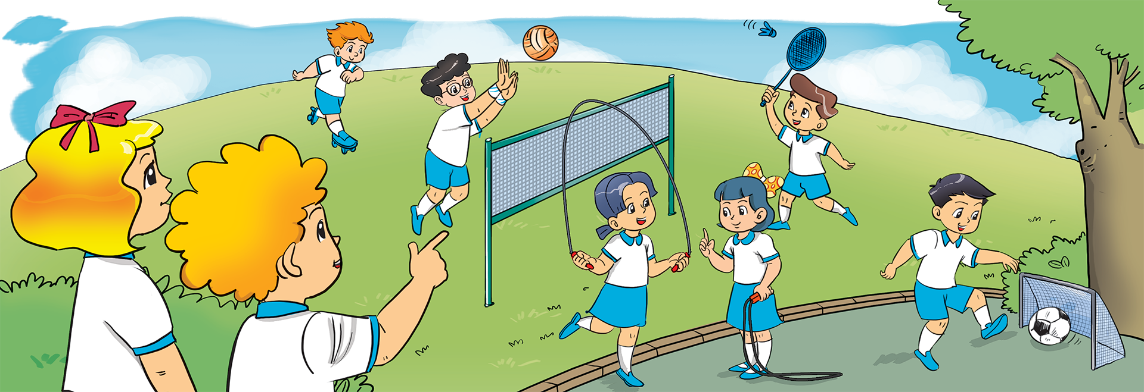
3. Let's talk.
Linda
Is that _________?
Yes, it is.

Slide 9
3. Let's talk.
Is that _________?
Linda
No, it isn’t.
It’s ______.

Slide 10
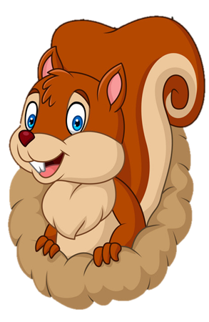
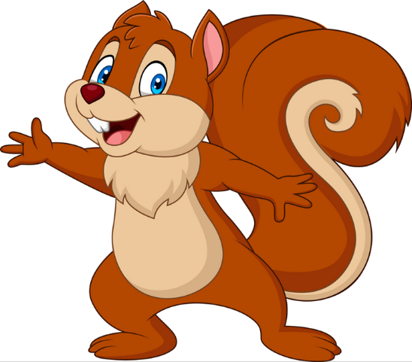
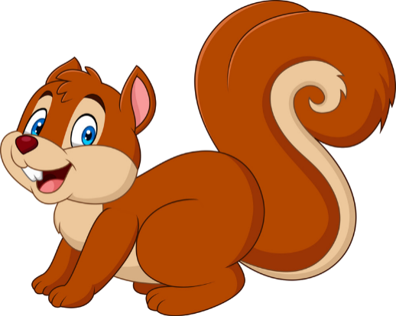
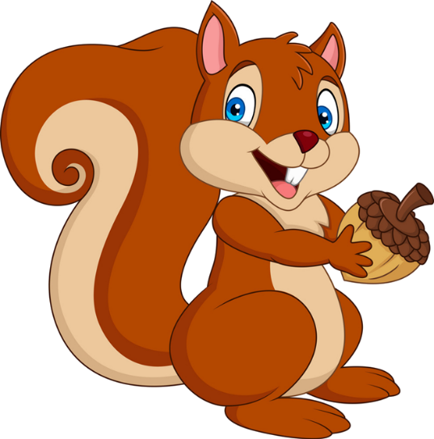
PLAY
NEXT
Brown squirrel
& acorn

Slide 11
Is that Quan?
Yes, it is.
No, it isn’t.
farm
zoo

Slide 12
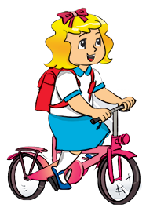
Is that Linda?
Yes, it is.
No, it isn’t.
farm
zoo

Slide 13
Is that Linda?
Yes, it is.
No, it isn’t.
farm
zoo

Slide 14
Is that Nam?
Yes, it is.
No, it isn’t.
farm
zoo

Slide 15
Is that Phong?
Yes, it is.
No, it isn’t.
farm
zoo

Slide 16
Is that Tom?
Yes, it is.
No, it isn’t.
farm
zoo

Slide 17
Is that Mai?
Yes, it is.
No, it isn’t.
farm
zoo

Slide 18
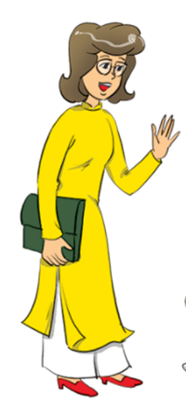
Is that Miss Hien?
Yes, it is.
No, it isn’t.
farm
zoo

Slide 19
Good job!

Slide 20
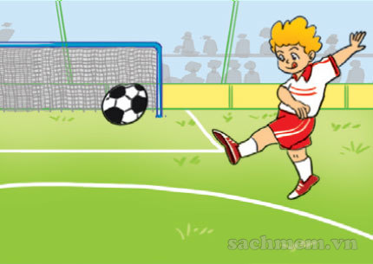
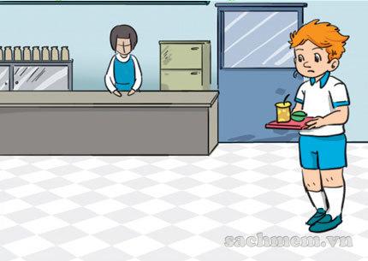
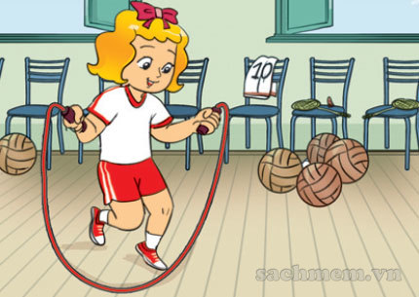
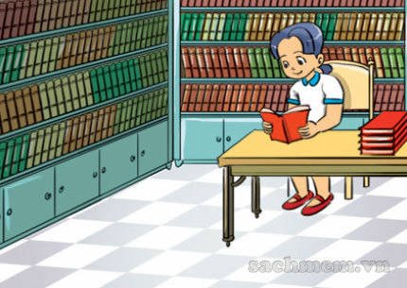
4. Listen and number.
1
2
3
a
3
b
2
4
c
1
d
4

Slide 21
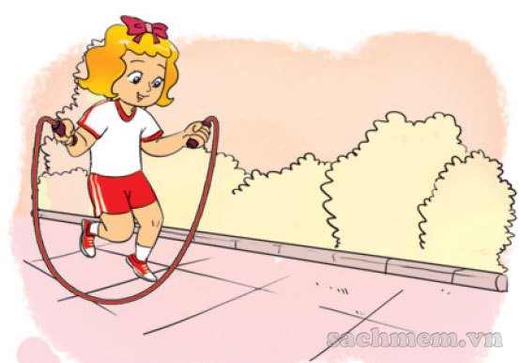
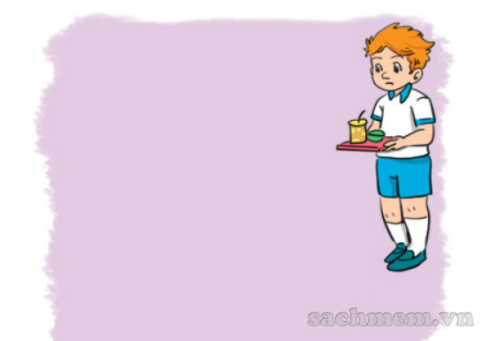
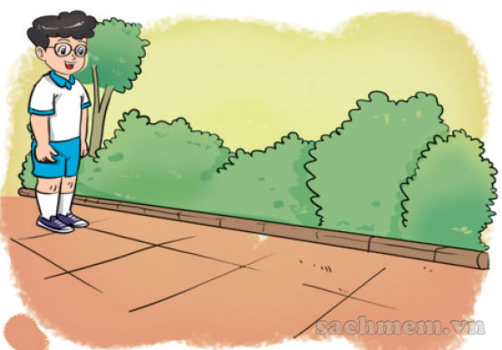
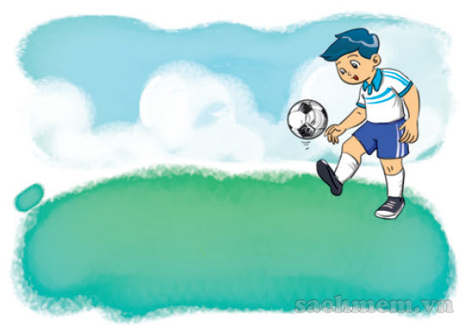
5. Look, read and answer
Is that Linda?
_____________.
2. Is that Peter?
_____________.
Yes, it is.
No, it isn’t.
3. Is that Phong?
_____________.
4. Is that Nam?
_____________.
Yes, it is.
No, it isn’t.

Slide 22
6. Let's play.

Slide 23
THANK YOU!
Welcome to join with me!

